Slide 1
Digital Forensics Workshop
BSidesPDX 2023

Slide 2
Who are we?
Portland State University
Cybersecurity Club
Our mission is to promote security culture, ethics, research, ongoing education, and development of safer code through playing in Capture the Flag competitions.

Slide 3

PSU Cybersecurity Club
Open to students of all majors!
Weekly training meetings!
CTF competitions on weekends!
Upcoming Events:
National Cyber League
DoE CyberForce Competition
Find us in the local security community:
BSidesPDX, Rainsec, OWASP, Def Con, and more…

Slide 4
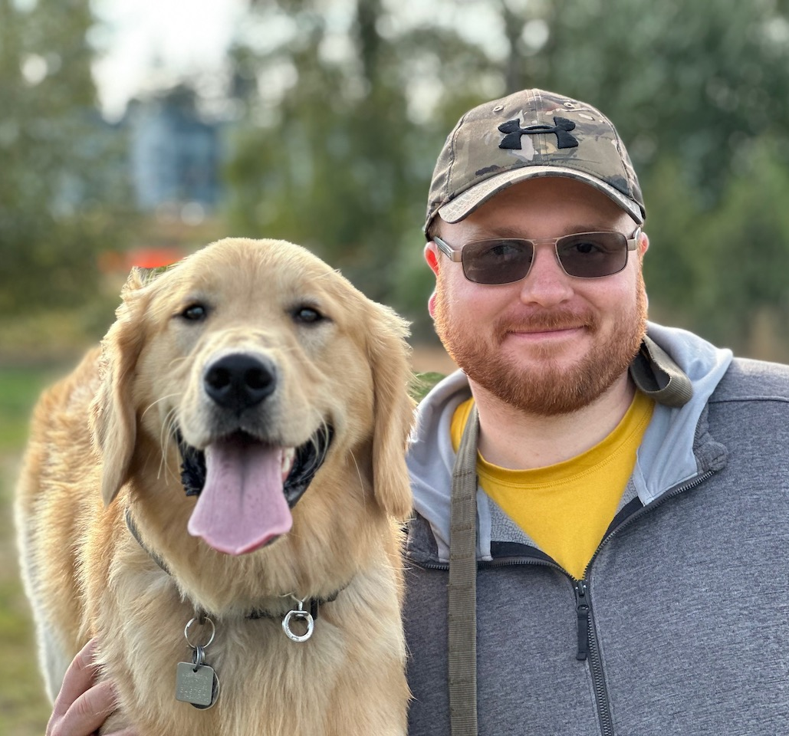
Travis Noyes
Grad student, Computer Science / Security
Cybersecurity club president
Infosec team intern for PSU
Lifelong learner or something

Slide 5
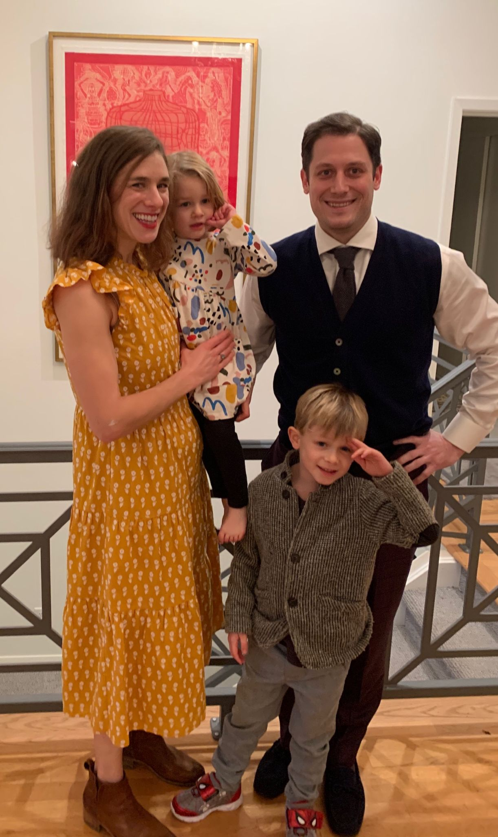
Lance Miller
PSU Grad Student in the Computer Science Department
Cyber Security Enthusiast
Officer Portland State Cybersecurity Club

Slide 6
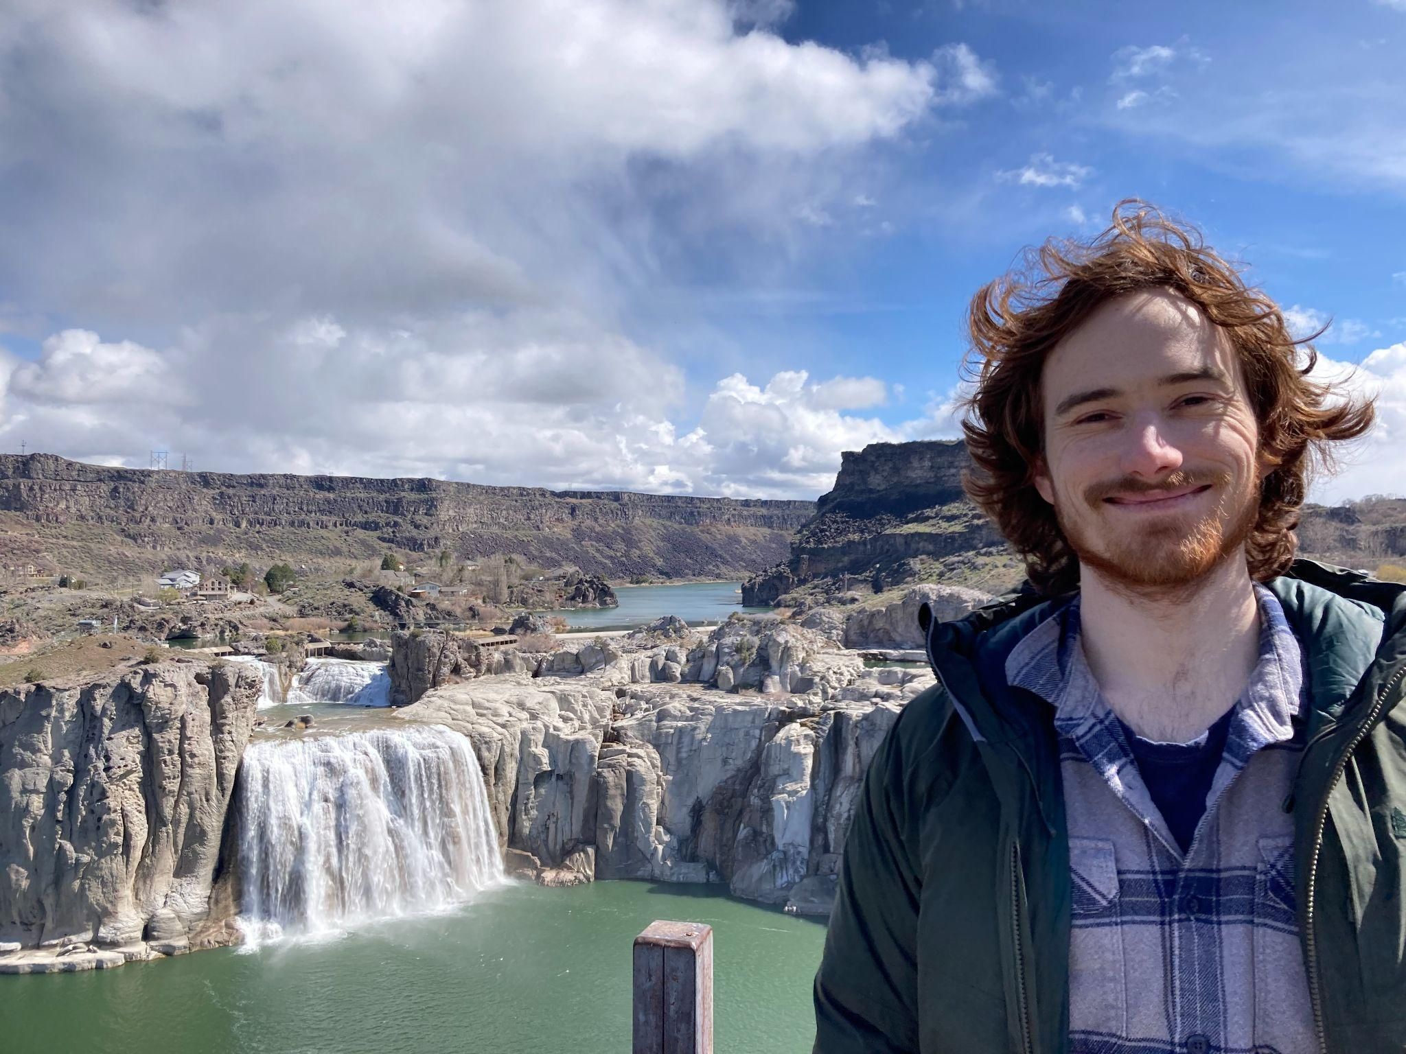
David Baker-Robinson
PSU Grad Student in CS
Works for CAT (Computer Action Team)
Enjoys RE (Reverse Engineering) CTF’s
Excited about CyberForce and NCL

Slide 7

Cybersecurity Graduate Certificate
CS 591 Introduction to Computer Security
CS 595 Web and Cloud Security
CS 554 Principles of Software Engineering
CS 555 Software Specification and Verification
CS 556 Software Implementation and Testing
CS 576 Computer Security Seminar
CS 585 Cryptography
CS 592 Malware Reverse Engineering
CS 593 Digital Forensics
CS 594 Internetworking Protocols
CS 596 Network Security
Notes:
PSU offers many upper-division Computer Science courses with a security focus
Take enough classes and earn a Cybersecurity Graduate Certificate
Most of the information in this workshop is based off CS593
My favorite class was probably Network Security (besides forensics of course)
https://www.pdx.edu/computer-science/cybersecurity

Slide 8
Coming up
What is digital forensics?
Files and file systems
Tools
File carving demo
Metadata.. and more
CTF

Slide 9
What is digital forensics?

Slide 10
“Forensic science is the use of scientific methods or expertise to investigate crimes or examine evidence that might be presented in a court of law.”
National Institute of Standards and Technology (NIST)
Notes:
Forensics can cover just about anything
Autopsy, Ballistics, Fingerprinting, Toxicology…

Slide 11
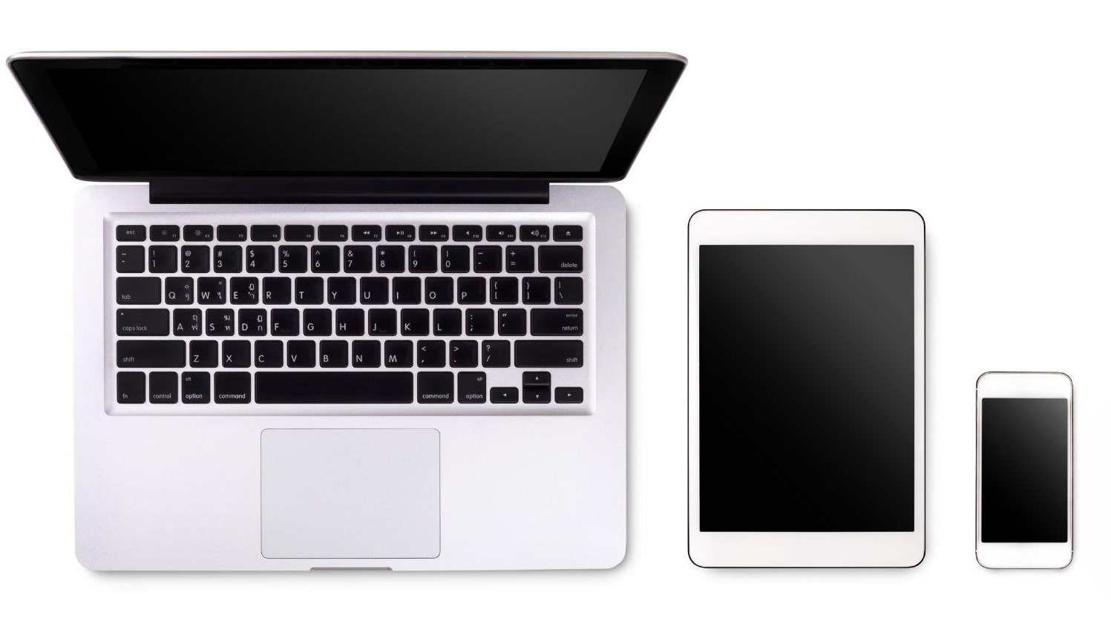
What is digital forensics?
Focusing on the collection and examination of data stored electronically
Sources could be from:
Computers
Cell phones
External drives
Remote storage
Networks
and much more!
Notes:
You’ll find that nearly every criminal investigation now includes some kind of digital evidence
We are attached to our devices every day and create a huge paper trail
https://www.vecteezy.com/photo/10452081-laptop-tablet-smartphone-and-coffee-on-white-background-with-text-space-and-copy-space

Slide 12

Who needs digital forensics?
Law enforcement,
Companies,
Lawyers,
… Everybody!
Notes:
Crime investigation
Investigating employee behavior
Recovering lost files
https://www.vecteezy.com/png/9385543-magnifying-glass-clipart-design-illustration

Slide 13
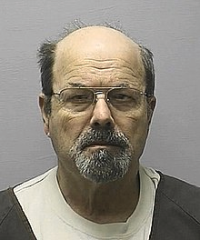
Digital forensics in real life
The BTK serial killer
Taunted law enforcement and reporters with pictures and puzzles
Tracked a floppy disk to his church and found him guilty
Notes:
He sent a floppy disk to a local Fox affiliate, which was turned over to law enforcement.
They were able to extract deleted files and in the metadata found reference to Christ Lutheran Church, files attributed to user Dennis
https://en.wikipedia.org/wiki/Dennis_Rader

Slide 14
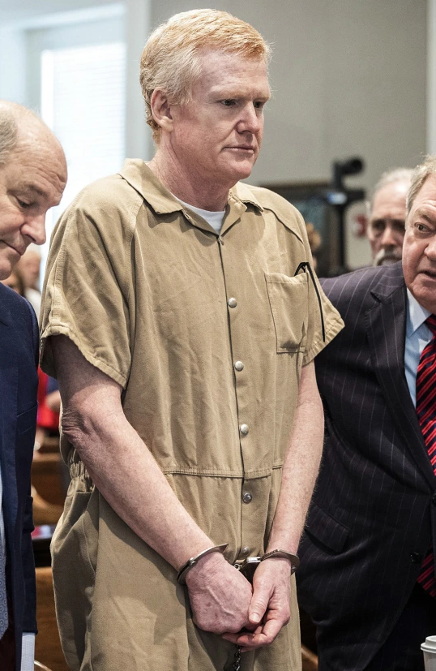
Digital forensics in real life
Murdaugh Murders
Prominent South Carolina attorney accused of killing his wife and son at their home
He denied being there at the time of the murder
Secret Service gained access to son’s phone and found video evidence proving he lied
Notes:
There really is so much more to this case, but ultimately it was digital evidence that tipped the scales against Alex
https://d3i6fh83elv35t.cloudfront.net/static/2023/09/GettyImages-1528562077-1200x800.jpg

Slide 15

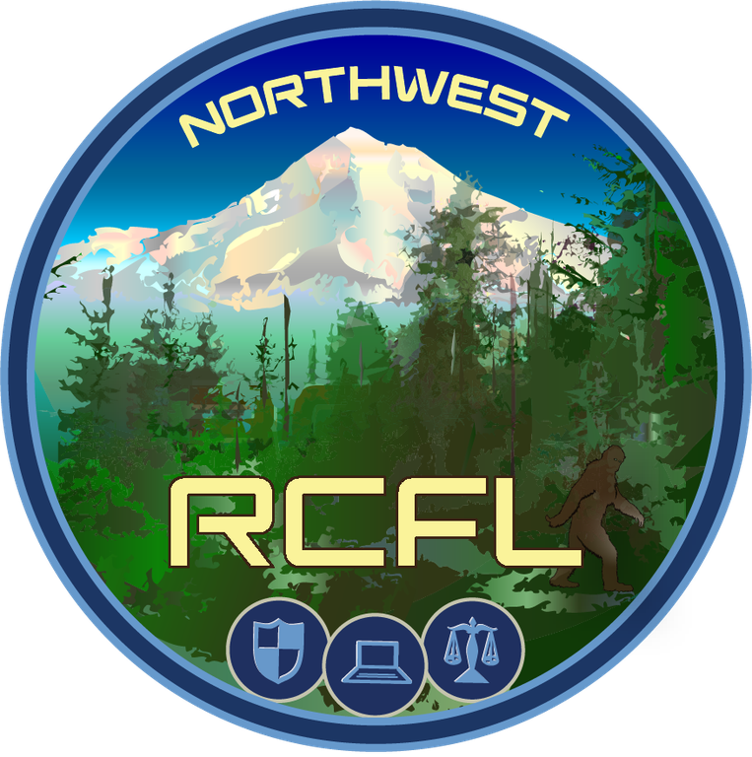
Digital forensics in our community
Washington County
Digital Forensics Lab
Northwest Regional
Computer Forensics Lab
Notes:
Works with law enforcement on criminal cases and investigations
https://www.washingtoncountyda.org/news/washington-county-digital-forensics-laboratory
Alternate https://www.facebook.com/washcoda/videos/washington-county-digital-forensics-lab/1543921119076182/
https://www.rcfl.gov/northwest

Slide 16
Files and File Systems

Slide 17
What is an artifact?
Stuff left behind to discover
Operating System
Windows event log, registry, dmesg, /var/log
File systems
Access/modification/creation timestamps, metadata

Slide 18
Digital Artifacts
Disk artifacts
Physical remnants left by manipulation of the file system
Different from file system artifacts
Caches hold data before the magnets actually write things, even though it can report that the write was successful

Slide 19
Digital Artifacts
Higher level
Browsers, internet history, saved passwords
Documents / Media (photos, videos, audio)
Databases, often applications keep these for their internal data
General application data
Very specific, like from Steam, or Microsoft Teams, etc

Slide 20
What are files?
Stored information on a computer
Basically everything is a file
Size, timestamp, source, type, etc
Common metadata attached to files
Metadata + data = file

Slide 21
File types
Media: Images, videos, audio recordings
Documents: PDFs, Word / Excel, HTML
Executables: Applications, scripts, malware

Slide 22
Extension vs file format
File extension
.jpg, .pdf, etc
Hints at the type of file
File format
The actual way data stored is encoded
Follows a specification for each type of file

Slide 23
Headers and hexadecimal
Each file is a sequence of bytes
Viewable through tools like xxd
JPEG images
Start with FF D8
End with FF D9
Notes:
https://en.wikipedia.org/wiki/List_of_file_signatures

Slide 24
File systems (Windows)
Master file tables
FAT - File Allocation Table - Windows
NTFS - New Technology File System - Windows
Notes:
A file system is a data structure that the OS uses to organize everything for storage and retrieval

Slide 25
File Systems (Linux / UNIX)
Files are streams of bytes, kept track of as inodes
ZFS - Zettabyte File System - Linux/ MacOsx
EXT - Extended Filesystem - Linux
Notes:
Of course there is not a universal file system

Slide 26
Allocated vs Unallocated space
File system tracks what storage is in use or free
Blocks previously written are not immediately overwritten when released
Artifacts can be collected if you’re quick enough
Notes:
So when you free data, it isn’t really gone until you write over it. It is just marked as free. And even then you have to write over it seven times for a safe delete. Im not sure why that is

Slide 27
Partition maps
MBR (Master Boot Record), doesn’t work in UEFI, it’s old school. BIOS only
GPT (GUID), EFI map
APFSX (apple computers)
Notes:
Gpt can have more partitions per drive. Tell anecdote about upgrading to windows 11.

Slide 28
Sparse files
Slack space
Block 1 | Block 2 | Block 3 | Block 4 | Block 5
A | A | A | A | B | B | B | B | C | C |  |  | D | D | D | D
File A
File B
File C
File D
Unallocated block
Slack space
Notes:
Slack space is the space not used by a files allocated memory

Slide 29
Storage hardware types
HDD ATAPI parallel interface / SCSI or SAS (serial attached SCSI)
SSD SATA serial interface
NVME PCIe / M.2
USB Flash
SD card / CF card
DVD / BluRay
Differences in shelf stability, power needs, random data corruption, etc
Notes:
You don’t want to leave data on the original drive too long if it has a shelf life, it could become corrupted. Make copies. Flash drives have software built in to ensure that bit flipping is spread out, because each bit can only be written to a certain number of times.

Slide 30
Disk Images
Types of image files
Raw Single (*.img, *.dd, *.raw, *.bin)
Raw Split (*.001, *.002, *.aa, *.ab, etc)
and many more
Write blockers
Software vs hardware
Notes:
Software like encase and ftk imager have write block capabilities. Whatever you do, you should always checksum to make sure that nothing has been corrupted.

Slide 31
Tools

Slide 32
Tools
Ubuntu Linux VM
Linux forensics tools are easy to use
Lots of options for host operating systems
Windows: VMWare, VirtualBox, WSL2
MacOS: UTM, Parallels

Slide 33
Tools
dd / dc3dd
$ sudo apt install dc3dd
AKA Disk Destroyer
Directly interact with block devices
Backup partitions or backup entire linux disk
Wiping a hard drive (overwrite with zeros)
Notes:
https://en.wikipedia.org/wiki/Dd_(Unix)
https://www.kali.org/tools/dc3dd/

Slide 34
Tools
sha256sum
$ sha256sum <filename>
Check the hash of a disk image or file download to make sure it is correct
Especially helpful if you can’t use a package manager for a certain set software and have to manually create it with make utility

Slide 35
Tools
binwalk
$ sudo apt install binwalk
Used to search for embedded files and executable code
Relies on the use of Magic numbers and other file statistics
Find entropy in files, extract files, search for custom signatures
Notes:
https://www.kali.org/tools/binwalk/
I put this one in the workshop description so we should at least talk about it but
I bricked my Ubuntu VM trying to practice file extraction with it…

Slide 36
Tools
xxd
$ xxd <filename>
exiftool
$ sudo apt install libimage-exiftool-perl
$ exiftool <filename>
xmllint
$ sudo apt install libxml2-utils
$ xmllint --format <filename>

Slide 37
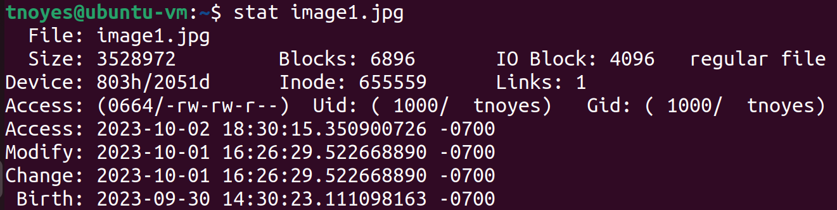
Tools
stat
$ stat <filename>
Notes:
https://www.geeksforgeeks.org/stat-command-in-linux-with-examples/

Slide 38
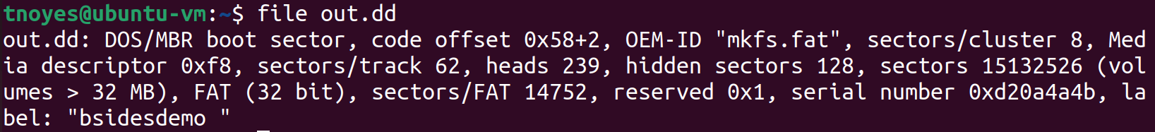
Tools
file
$ file <filename>
Notes:
Useful for at-a-glance information a file
I’ve used this in CTFs before when examining unknown downloads to see if they are executables, etc

Slide 39
Tools
find
grep
Regular expressions

Slide 40
Tools
Sleuthkit
$ sudo apt-get install sleuthkit
Collection of tools to extract files from a variety of file types (different forms of storage)
fls Lists both unallocated and allocated files of a file system
icat Copies image file with specified inode to standard output
Mmls Lists where partitions begin and end
Often used in combination with dd
Notes:
https://www.sleuthkit.org/
https://wiki.sleuthkit.org/index.php?title=Fls

Slide 41

Fancy Tools
Autopsy
Industry standard
Open source, very extensible
Provides a graphical interface for tools like sleuthkit
Notes:
https://www.autopsy.com/

Slide 42
File Carving Demo

Slide 43
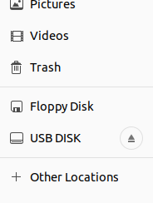
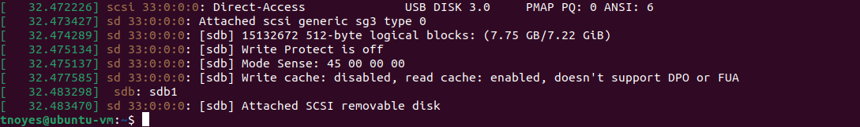
Connect USB device to Ubuntu VM
Plug in the device to an open USB port
Open Terminal and look for the device name
$ sudo dmesg or $ sudo fdisk -l
Notes:
VMWare Workstation Player
If it doesn’t get recognized, power down the VM and open virtual machine settings
Under USB Controller, set USB compatibility to USB 3.1
Oracle VirtualBox
If the USB isn’t recognized, download the VirtualBox Extensions and enable USB 3.0 in settings

Slide 44
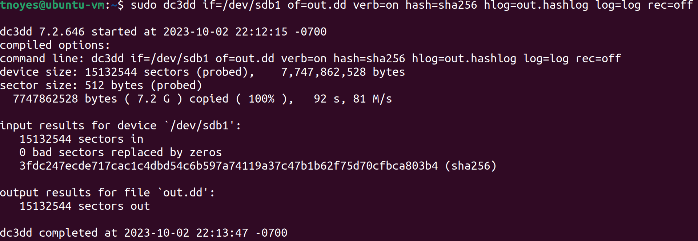
Creating a disk image
Use dc3dd to create a forensic copy of the external storage device
$ sudo dc3dd if=/dev/sdb1 of=out.dd verb=on hash=sha256 hlog=out.hashlog log=log rec=off
Notes:
To install dc3dd use `sudo apt install dc3dd`
Command: dc3dd if=/dev/sdb1 of=out.dd verb=on hash=sha256 hlog=out.hashlog log=log rec=off
Make sure to change the if=/dev/<devicename> to match what you found in your system
Ideally this would be done with a hardware write-blocker attached, but they are very expensive!
A software write-blocker is a good compromise.

Slide 45
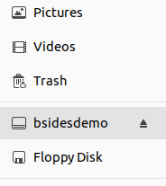
Mount the Image
$ mkdir ~/out
$ sudo mount -o loop,ro,noexec out.dd ~/out
What do the flags mean?
-o (options)
loop mount using an unused unspecified loop device
ro mount the filesystem as read only
noexec disables execution of binaries on the mounted filesystem

Slide 46
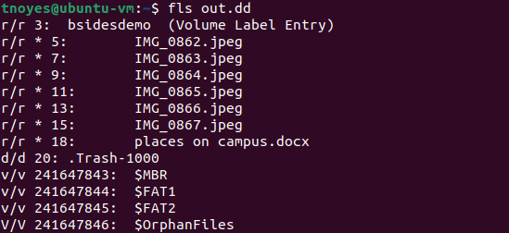
Start Sleuthing
Use fls (part of sleuthkit) to investigate the image contents, if any exist
$ fls out.dd

Slide 47
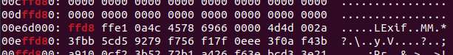
Manual File Carving (jpeg)
JPEG magic numbers
Header 0xffd8
Footer 0xffd9
Look for any JPEG file headers in the disk image
$ xxd out.dd | grep -m 30 “ffd8”
Notes:
Every file contains metadata readable by the file system to describe the type of file
Magic numbers are just bytes at the beginning of a file
grep -m 30 just limits the output results to the first 30
You might not always have a clean break where the “ffd8” is located. You might have to grep for “ff d8” if it is split up.

Slide 48
Manual File Carving (jpeg)
How to read xxd + grep output
Offset from starting address
0 1 2 3 4 5 6 7 8 9 A B C D E F
Starting address
Bytes in hex pairs
ASCII

Slide 49
Manual File Carving (jpeg)
Repeat for the footer
First byte 0x00E6d000
Last byte 0x011CA900 + 0xC (12 bytes) = 0x011CA90C
Converting starting and end bytes from hex to decimal
First byte -> 15126528
Last byte -> 18655500

Slide 50
Manual File Carving (jpeg)
Calculate the file size in bytes by subtracting the end from the starting byte
18655500 − 15126528 = 3528972
Last byte First byte File size
3528972 bytes (~3.5 MB)

Slide 51
Manual File Carving (jpeg)
Extract the file with dd
$ dd if=out.dd of=image1.jpg skip=15126528 bs=1 count=3528972
skip This is the starting byte in decimal format we calculated earlier
count The total number of bytes in the file size from earlier

Slide 52
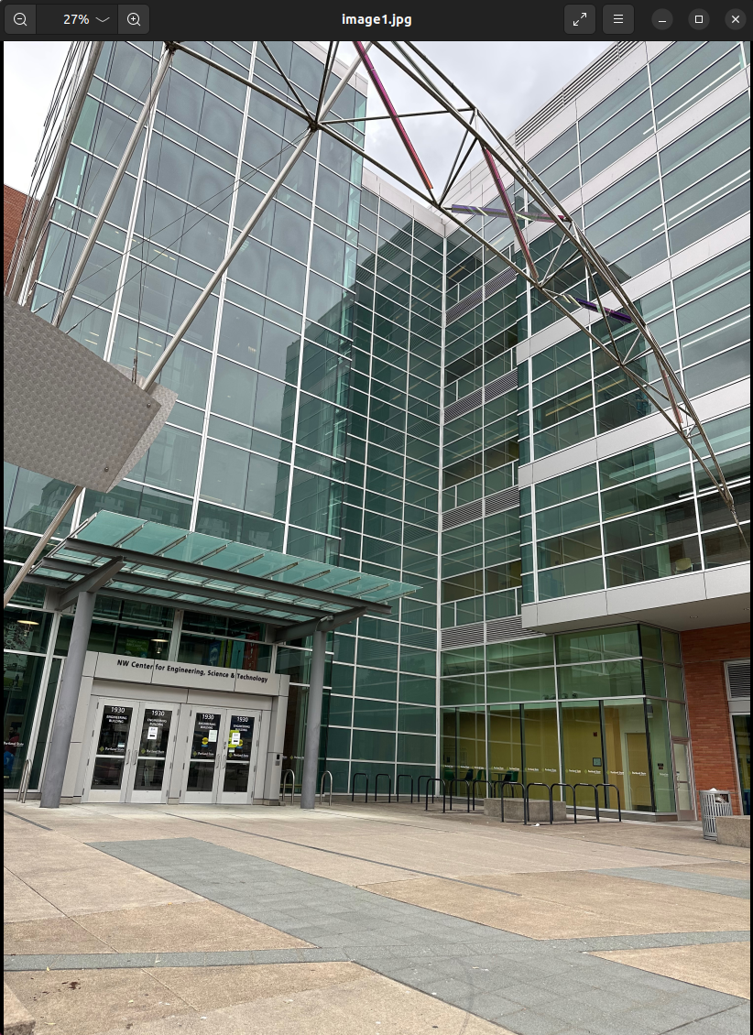
Manual File Carving (jpeg)
View the extracted image
Can you guess where this is?
Notes:
There are a lot of things that can go wrong here, so don’t worry if you don’t get it the first time!
Check the math on starting and end addresses again. Double check conversion from hex to decimal.

Slide 53
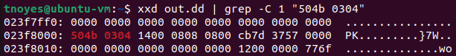
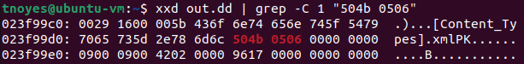
Manual File Carving (.docx)
Header 50 4B 03 04 14 00
Footer 50 4B 05 06 (plus 18 bytes after)
$ xxd out.dd | grep -C 1 “504b 0304”
$ xxd out.dd | grep -C 1 “504b 0506”
Notes:
grep -C allows you to show “context” of a number of lines above and below the found search string

Slide 54
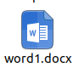
Manual File Carving (.docx)
Start 0x023f8000 37715968 (decimal)
End 0x023F99E0 + 0xE = 0x23F99EE 37722606 (decimal)
File size 6638 bytes (~6.6kB)

Slide 55
Wait, are you serious!?
Isn’t there some easier way?
(what I probably said the first time I learned this stuff)

Slide 56
Automated File Carving
foremost
$ sudo apt install foremost
$ foremost -T -t jpg -i out.dd
… and DONE!
Notes:
Yes these tools make it a whole lot easier to carve files
They aren’t always 100% accurate though, so you might have to get your hands dirty the hard way sometimes
Files located by foremost will be created in a new directory

Slide 57
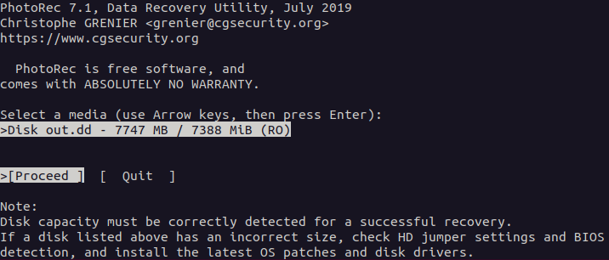
Automated File Carving
photorec
$ sudo apt-get install testdisk
$ sudo photorec out.dd
Notes:
Photorec is another alternative and can be more effective sometimes
In this particular example, photorec was able to detect the .docx file on the drive as a bonus to the pictures
Linux version has a simple GUI in the terminal
Choose to locate files in the “Whole” partition, not just unallocated space

Slide 58
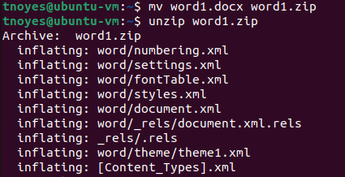
Word Documents
Try changing a .docx into a .zip file
View with xmllint
$ xmllint --format word/document.xml

Slide 59
Metadata and More

Slide 60
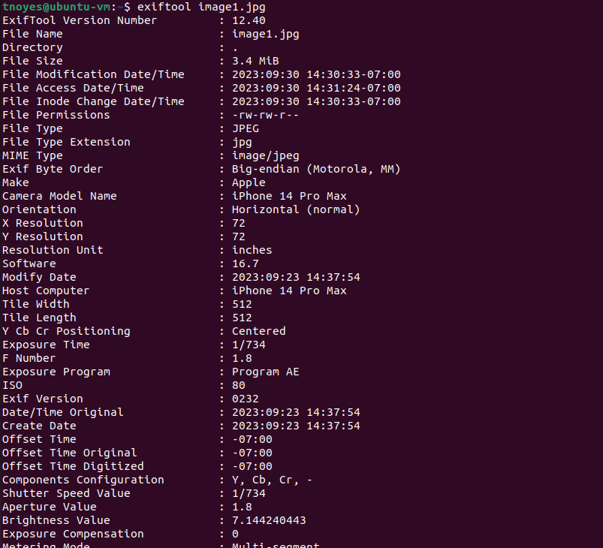
Examine JPEG metadata
$ exiftool image1.jpg
File Type
Timestamps
Camera model
… even GPS information!

Slide 61
Mapping GPS Coordinates
Create a map using Python!
$ sudo apt install python3-pip
$ pip install folium geopy pandas exifread
Download this script from Github:
https://github.com/dkmcgrath/sysadmin/blob/main/find_coords.py
Notes:
The author of this script is our Digital Forensics instructor at PSU, and he gave permission to share it in this workshop!

Slide 62
Mapping GPS Coordinates
Execute the script in the same directory as the photos.
$ python3 find_coords.py

Slide 63
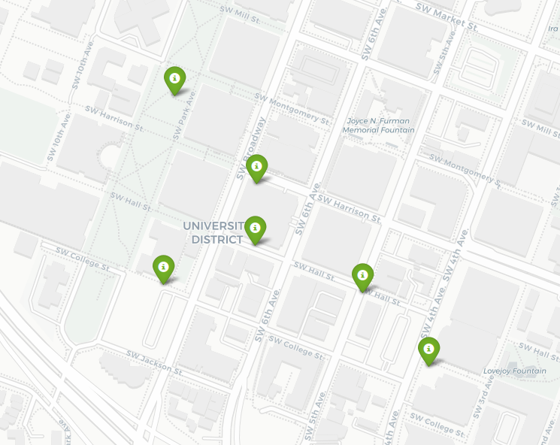
Mapping GPS Coordinates
Open the resulting file called “map.html” in a web browser, and view the map!

Slide 64
CTF
github.com/PSU-Cybersecurity-Club/forensicsdemo
Notes:
https://github.com/PSU-Cybersecurity-Club/forensicsdemo

Slide 65
Okay, time to wrap up!

Slide 66

More fun!
Autopsy
Disk Analysis & Autopsy
Linux Server Forensics
Windows Forensics 1
Windows Forensics 2
Wireshark 101

Slide 67
Where to find us…
Website psusec.org (Coming soon!)
Discord https://discord.gg/2QKup4BryT
PSU Connect https://pdx.campuslabs.com/engage/organization/PSUSec

Slide 68
Questions?

